Slide 1
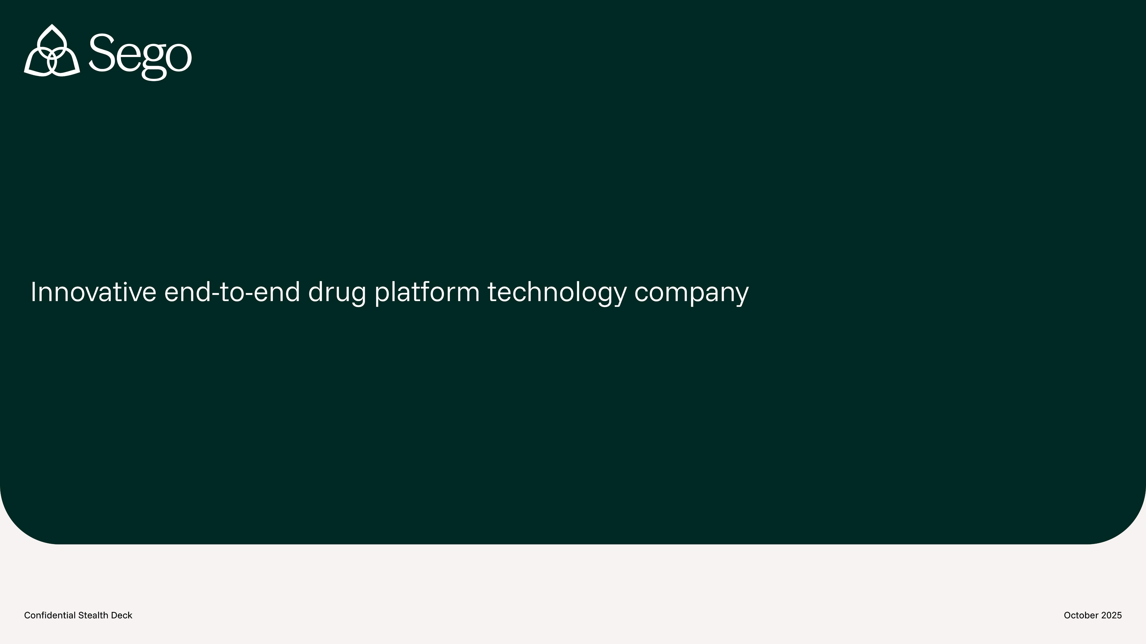
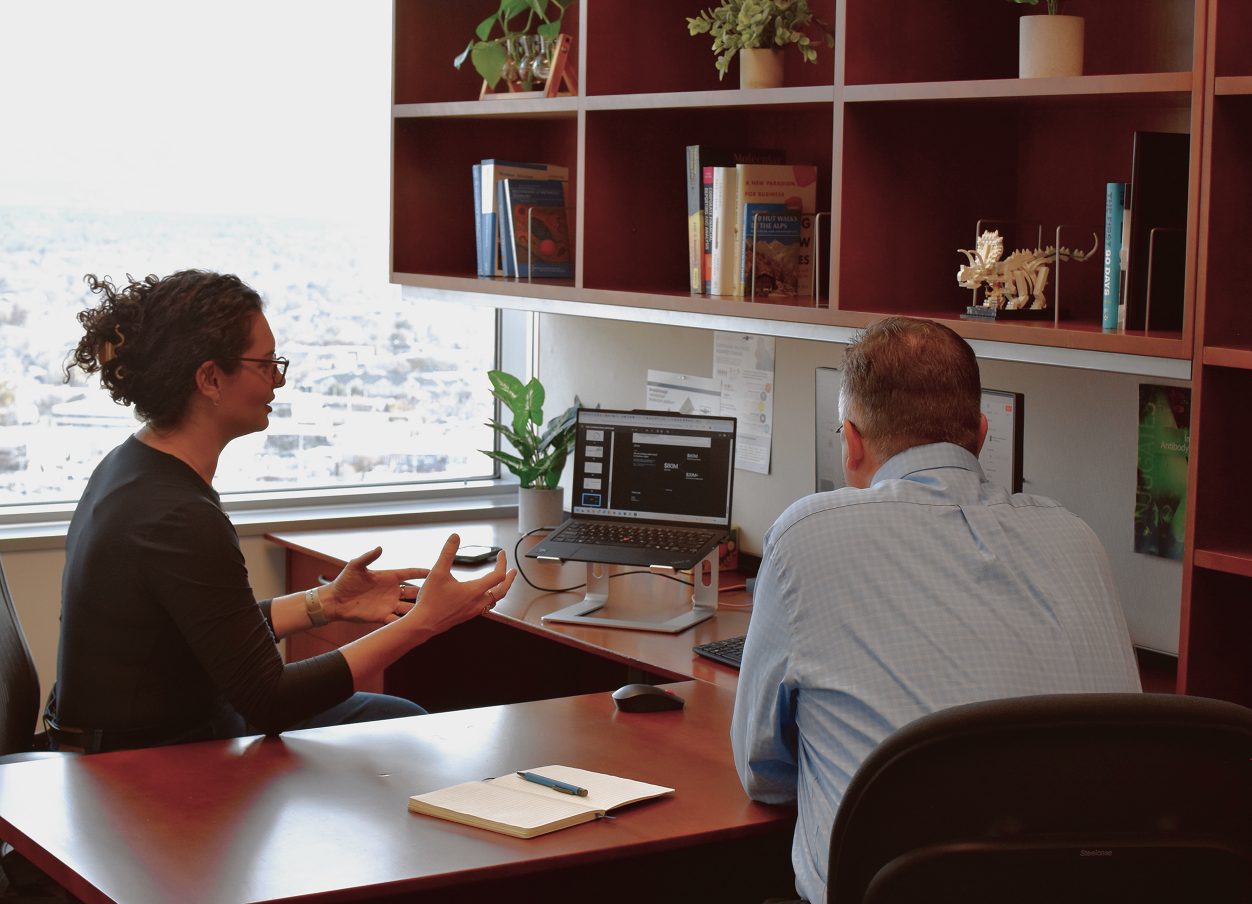
Sego Therapeutics
Hot medicines, fast
July 2026

Slide 2
China strategy
Team intro
Chinese ecosystem overview
Goals of china visits – funding, cros, build partners, JVs
Funding
Brief stats on funding convos
Assets
Asset license financials
Stats on asset conversations
Promising lead one: BFC partnership
Promising leads – Specific assets (see other slides)
Route forward – discussions with XYZ companies, target evaluation
Chinese deal structure for JV or co development

Slide 3
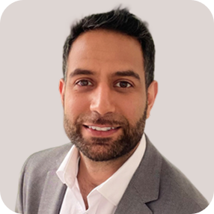
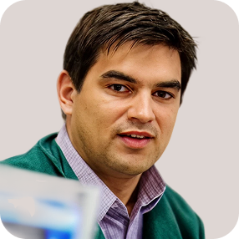

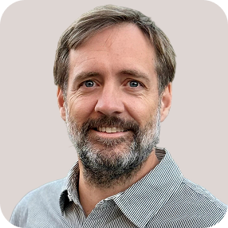



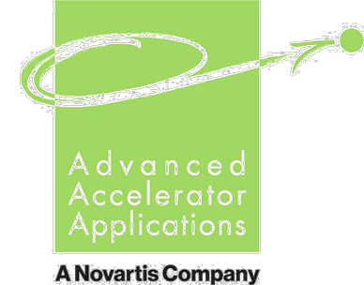







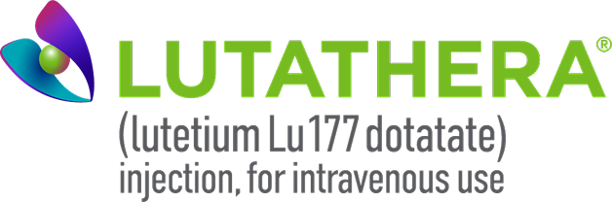


15+ domain area experts led by 4 founders with deep domain expertise in radiopharma
Our Team
Jeevan Virk, CEO
Greg Mullen, PhD, CTO
Adam Badar, PhD, Head of Operations
Richard Tavaré, PhD, Head of Research
Pioneer in RLT field. Last role heading RLT Strategy at market leader Novartis
19 years experience in radiopharma
Worked directly with founders at AAA
Central to research, development and commercialization platform for Pluvicto & Lutathera
Key player in 5 Novartis deals with Mariana Oncology ($1b+), Peptidream, Chengdu Baiyu, plus others
25 yrs of radiopharma R&D, clin dev and commercialization experience
Drove FDA approval of Nephroscan diagnostic
Translated multiple products into FIH, Phase 1 and 2 clinical studies
M&A: Out licenses to AAA/Novartis, exit of Theragnositics for $41M
C-suite experience, in licensing, IP, fundraising
15 yrs in nuclear medicine, oncology, technology development & innovation
Experience in product, partner, and customer development
Building and managing cross- functional consulting teams
Experience in operational and project management in Agile
15 yrs oncology diagnostic and therapeutic drug development in academia and pharma
Led to three molecules in imaging clinical trials
Acquired cyclic peptide company for capabilities at Regeneron
PhD Imaging Immunology

Slide 4
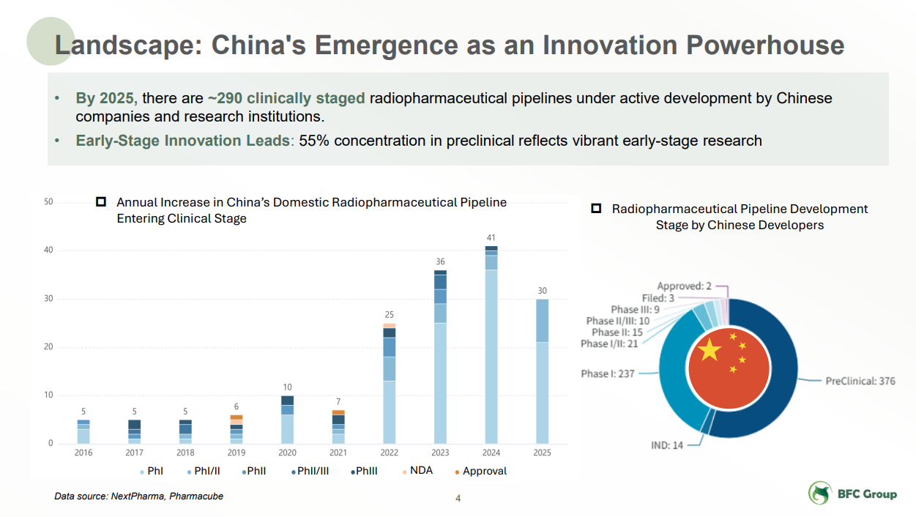

Slide 5
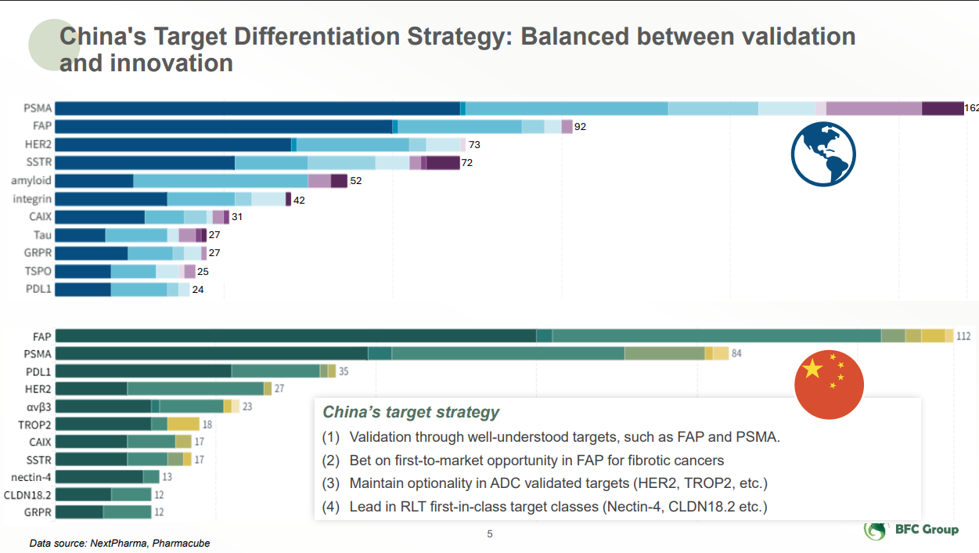
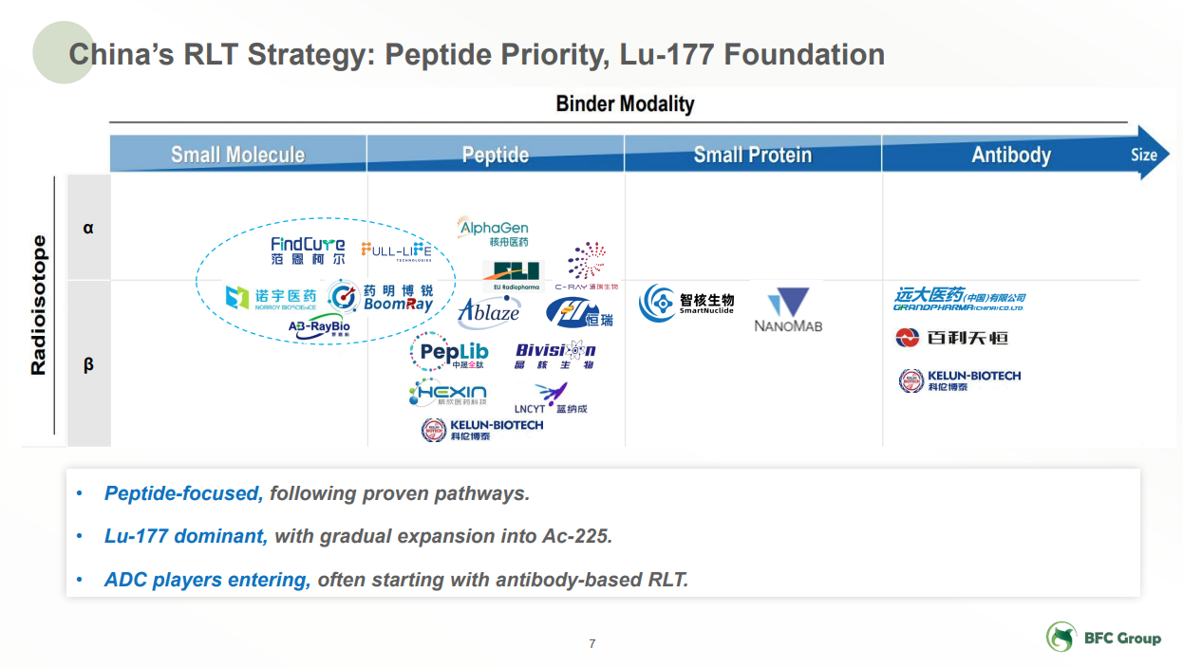
Our view: there are gems, but innovation somewhat lower. Peptide repurposing common.

Slide 6
In a sea of Chinese assets, the right team wins twice
The Opportunity
China has more RLT assets than good ones — roughly 290 clinically staged programs, unevenly good.
The scarce ingredient is a team that can tell the difference.
What the right team must do
What it earns
1
Search
Find the few exceptional assets in a deep, uneven field
Valuable exit
Out-license or sale of the de-risked asset to Western pharma
1
2
Enable
Assemble the regulatory and development pieces to run ex-China
De-risk
Take early, low-cost risk to a human-data inflection
2
Enduring partnerships
Trusted access to China's best innovators — a pipeline of future assets
3
Sego is that team: the discipline to select, the platform to develop ex-China, and the relationships that compound.

Slide 7




Sego’s world class team and headquarters make for a unique opportunity to bridge between Chinese & US/EU RLT ecosystems
Sego in China
World-class RLT Operators
Global Development & Launch Capabilities
Near-term, Innovative Value Catalysts
Proven Value of RLT Investments
Decades of combined RLT R&D, commercialization experience
Led Pluvicto, Lutathera commercialization & major RLT M&A deals at Novartis
GMP capabilities at US Headquarters to supply ex-China trials & commercially
Established clinical trial network & regulatory strategy ex-China
Innovative FIH strategies, with first data in 2028. IND, human efficacy, & BD deals to follow rapidly. Each drives step-change valuations.
7 acquisitions >$1B in 2 yrs by big pharma: Novartis, BMS, AZ, Lilly
Returns of 5-10x common for early investors

Slide 8




Four ways Sego is looking to engage with the China RLT ecosystem
Sego in China
CROs
In-licensing
Equity Investments
Joint Ventures
Contract Research
Asset Access
Strategic Capital
Shared Programs
Access specialized chemistry, biology, and manufacturing capabilities at scale
Source novel assets, ideally with early human data, and lead development in US/EU
Secure investment in Sego’s mission from China’s divers investor base
Co-develop assets combining Sego's RLT expertise with local innovation & investment
Goal: Leverage Sego’s US footprint to bridge innovation between US and Asia

Slide 9
We turn a good Chinese molecule into a great therapy; capital is the accelerant
Why Sego
Deep translational RLT experience
Established US footprint
Clinical and regulatory strategy
What we need: capital
Pluvicto, Lutathera, Locametz and more
From the team that pioneered the field
US manufacturing for US and EU supply
Integrated hot and cold GMP under one roof
We turn a good molecule into a great therapy Rapid FIH paths and a global trial network
To source, develop and de-risk the assets
Blackstone funds the three bets

Slide 10
8
Asset In-License

Slide 11
In license criteria

Slide 12
Asset identification in china
Self guided
Retain guide
inbound

Slide 13
BFC
Context
Details of partnershp

Slide 14
Three bets across three targets in China
Three de-risked in-license bets, matched to Sego mechanism and BFC-flagged first-in-class RLT classes:
ACP3 - prostate (mCRPC); Sego lead target, internally validated
Nectin-4 - BFC first-in-class RLT class; ADC-validated (Padcev) in solid tumors
CLDN18.2 - BFC first-in-class RLT class; ADC and T-cell validated in gastric / GI
Not pursuing: DLL3, FAP - crowded fields and narrow therapeutic index

Slide 15
Three bets, cheap in, big out: one winner returns the portfolio
The Investment
1
License in
$5-15M upfront per asset, sourced in China
4
Out-license upfront
$350M post-FIH, benchmarked to recent RLT deals
2
FIH imaging study
~$5M; Phase 0 microdose in US or EU, delivers human data
5
Gross return
~10x on a single winning asset
3
US therapeutic study
~$20M; Phase 1 dose-finding
6
Three bets
~$105M total capital deployed across 3 targets
7
All-in to inflection
~$35M per asset to value-creating human data
8
One winner returns
~3.3x the portfolio; two winners ~6.7x
Use of proceeds: Blackstone capital funds license payments and ex-China development to the value inflection. Numbers illustrative.

Slide 16
13
Capital formation in China via two strategies: Traditional equity and JV

Slide 17
Two capital formation exercises in China
Equity investment in Parent Co
JV formation
Goal: Traditional equity investment / participant meeting CFIUS regs in parent co
Goal: JV formation with strategic partner, either investor / CRO / larger partent org
Status: LAV, Decheng, etc.
Status: Chempartner, etc.
Path forward: Enter diligence
Path forward: Enter diligence

Slide 18
Sego China Proposed Structure
15
Sego China
Investors
(China)
Sego
(US)
Assignment of Commercial Rights
Capital
300M RMB
All IP, preclinical and ex-China development
Chinese commercial rights to 2 assets
Funding & Equity
Commencement: 300M RMB (~$44M USD) sought to support the development and commercialization of an initial 2 assets
Clinical stage: Initial funding will support preclinical, Ph 0 and Ph 1 studies. Additional funding raised when molecules are in Ph 1.
Equity: To be discussed and agreed on (terms TBD)
Key principle: Sego US leads science & IP globally; Sego China gives Chinese investors exposure to Sego

Slide 19
Initial terms for Sego China formation
Sego China
1
Asset Selection
Sego assigns China commercial rights for 2 assets of current total 6 at their discretion to China Sego
4
Clinical Development
Sego China will sponsor Chinese trials. Sego US will sponsor global trials of the same assets.
2
Exclusivity
Exclusive Chinese commercial license
5
Isotope Supply & Manufacture
Isotope is supplied locally in China. Clinical & commercial manufacture of assets is also China based for Chinese supply.
3
Research
Sego US executes preclinical research & development
6
IP Rights
Sego US retains global IP ownership
7
Employee
One China-Based Alliance Manager (China ops, KOL management).
8
Exit
Tag/drag-along rights
Key principle: Sego controls science & IP globally; Sego China controls Chinese development & commercial rights.

Slide 20
Path towards establishing a Sego JV in China
5
Sego China
Phase 1 · Foundation (May – Aug 2026)
Phase 2 · Execution (Q3 – Q4 2026)
Intro Conversations
China Visit
Establish terms
Sego US Raise
Establish Sego China
Sego China Fundraise
1
2
3
4
5
6
In person or virtual introduction
Jeevan visits potential partners in person to discuss
Draft & revise terms on structure, governance, IP, equity split
Close of Seed Round
JV Entity formation & operation
Additional fundraise into Sego China
✓
✓
Late May
June
Jun – Aug
Q3
Q3/Q4
Q4

Slide 21
Case Example: China Grand Pharma investment in Australia-based Telix yields 10x returns in 5 years
Sego China
AUD 35M invested → AUD 361M total value (realized + held)
CGP return on investment in Telix (AUD M)
Investment timeline
2020 AUD 35M invested (~20.95M shares at AUD 1.69)
2022 Sold 10M shares at AUD 7.25 → AUD 72.5M realized
2025 Sold ~4.95M shares at AUD 28.90 → AUD 142.6M realized
Today 6M shares held, worth ~AUD 146.5M
Implication for investors in Sego
Early-stage entry at current private valuation offers significant multiple expansion as pipeline matures through IND and clinical proof-of-concept. Equity deepens alignment and captures upside from clinical milestones.

Slide 22
Back up slides not needed

Slide 23
Landscape
Confidential
4
China's radiopharmaceutical pipeline has exploded: ~290 clinically staged programs by 2025
~290
clinically staged pipelines
by Chinese developers (2025)
55%
of total pipeline still
in preclinical stage
Annual new clinical-stage entries by Chinese developers
Pipeline by development stage
Source: NextPharma, Pharmacube (via BFC Group)

Slide 24
We are prosecuting our first 5 targets based on criteria specifically matched to our mechanism of action
Process
40
12
5
Initial targets sourced
Underwent deep diligence
Targets selected for prosecution
Target Selection Criteria
Expression
Biology
Feasibility
Landscape
Tumor specific
Genomic & protein expression: TCGA, IHC scoring, proteomics
Review protein expression: heterogeneity & target density
Healthy tissue
Genomic & protein expression: GTEx, IHC scoring
Review expression: Key tissues (kidney, ocular), healthy vs. tumor specific accessibility (e.g. apical vs basal)
Human imaging
Prior imaging data that informs target expression/distribution
Biochemistry
Internalization & recycling rate
Shedding form & rate
Plasma half-life
Structural biology
Structure of membrane bound vs. shed forms
Conformations
Natural ligands & binding sites
Ligandability
Ability of target to be bound by a cyclic peptide
Translation
Availability of preclinical and clinical research methods
Radionuclide
Selection of radionuclide that best fits tumor, tissue & target
Unmet need
Current gaps in patient care with existing SOC & emerging therapies
Competition
Other trials/modalities against target & current results

Slide 25
Target Selection
Target 6 to be selected by opportunistic and disciplined BD process
Discussions in last 4 months by geography
In-License Evaluation Framework
1
Target strength
2
Multiple candidates
5+ groups
10+ groups
Data quality, competitiveness & FTO
3
Opportunities are largely outreach to Sego from Chinese biotechs & European academics. Key partner motivations are Sego’s founding team, US integration, global clinical network
Deal attractiveness
4
5
Strategic pipeline impact
No external asset has met all criteria to date. Primary decline reasons: low-priority target, single asset (no basket), narrow therapeutic index, lack of FTO

Slide 26
Our global clinical trial network & FIH regulatory approach
Key
GLP Toxicology required
No GLP Tox requirement
London, England
Lausanne, Switzerland
Salt Lake City, Utah
Shanghai, China
Use of rapid regulatory paths (e.g. USFDA eINDs) to select lead therapeutic candidate in humans
FIH studies seek to answer: Can you deliver enough dose (Gy) to kill tumor without reaching critical organ dose?
Whole-body organ and tumor dosimetry
Estimate Maximal Tolerable Dose
Maximum Injected Dose
Critical Organ Dose
Tumor Achieved Dose
Justification for higher starting dose in Ph 1 dose escalation studies
Global Clinical Trial Network
>5 global sites across US, EU, SA & AUS will be contracted
Multicenter Ph0 trials enables rapid completion of studies
Early recruiters for Ph 1 / 2 therapy studies.
Cape Town & Joburg, South Africa
Perth & Sydney, Australia

Slide 27
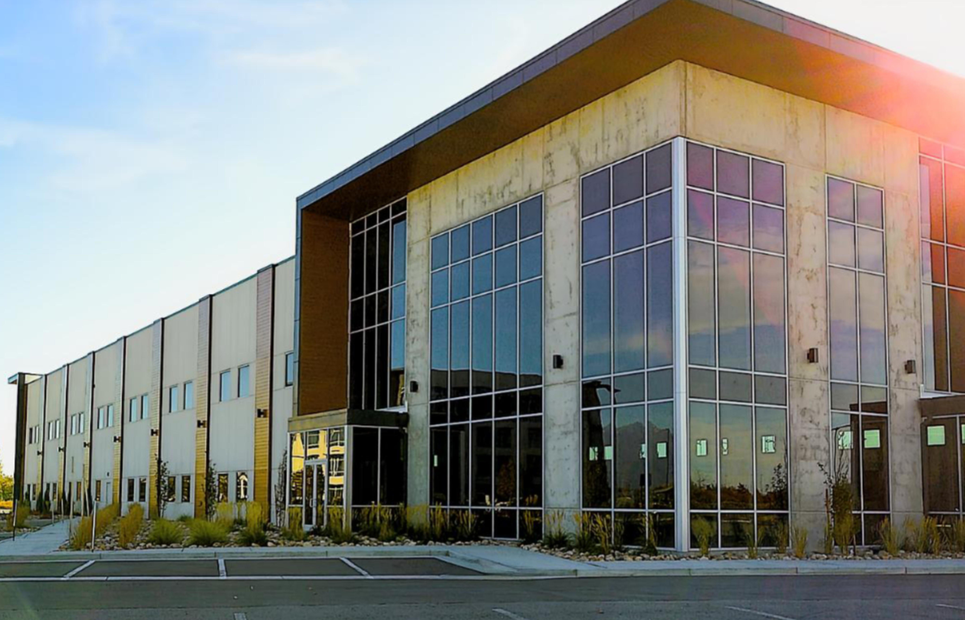
The world’s first radiopharmaceutical facility that houses research, development and commercialization under one roof
Integrated Supply Chain
67K sq ft in prime Salt Lake City location
Research & development labs
Full hot/cold lab spaces for chemistry, in vitro and in vivo work, including in-house imaging and vivarium
Clinical & commercial manufacturing
Planned capacity of 9 production lines for cGMP manufacturing, with 2 coming online in 2026
Our HQ building as of October 2025
Built to Sego’s specifications, with phased takedown
Building lease includes a phased take down to match payments with utilized floor space. Generous landlord TI allowance to support fit out financing
Talent pool
Extensive local AI/ML talent and a thriving life science community. Attractive city for relocation
Strategic location
0.5 miles to Nusano isotope production facility; 4 miles to SLC airport, with unrivalled coverage of N. America, multiple daily flights to Europe and Asia

Slide 28
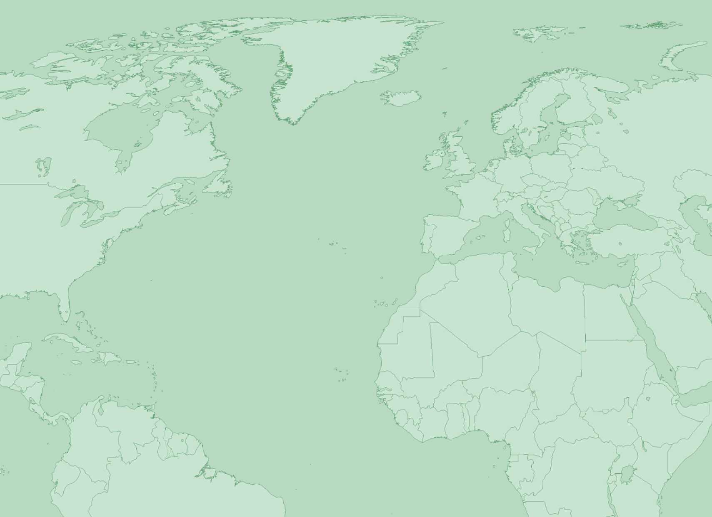
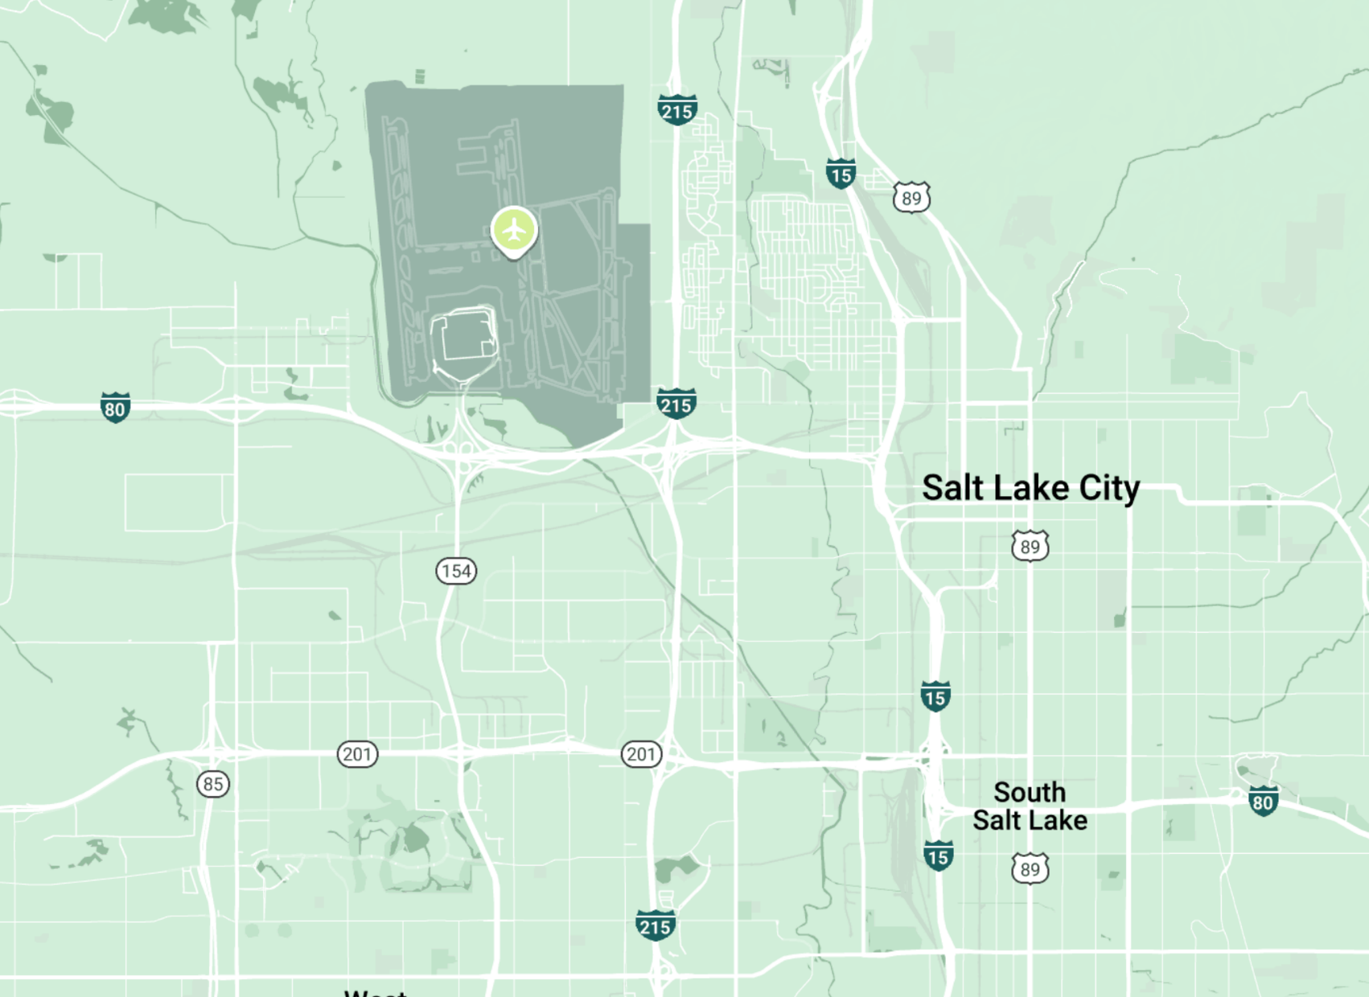
Sego’s integration keeps RLT supply chain simple with the goal of delivering drugs to patients more quickly & consistently
Integrated Supply Chain
Current state: Isotopes travel long distances
Our vision: All supply and manufacture in 5mi radius
Longer transit, more isotope decay & supply hiccups
Short transit, less time for isotope to decay
Western Russia Isotope Supply
East Coast U.S. Clear U.S. customs
SLC Int’l airport Fedex hub to global trial sites
Turkey Required stop in transit due to sanctions
5 mile radius
Indianapolis RLT Manufacturing Hub
Sego Drug manufacturing
Indianapolis Fedex hub to global trial sites
Nusano Isotope supply

Slide 29
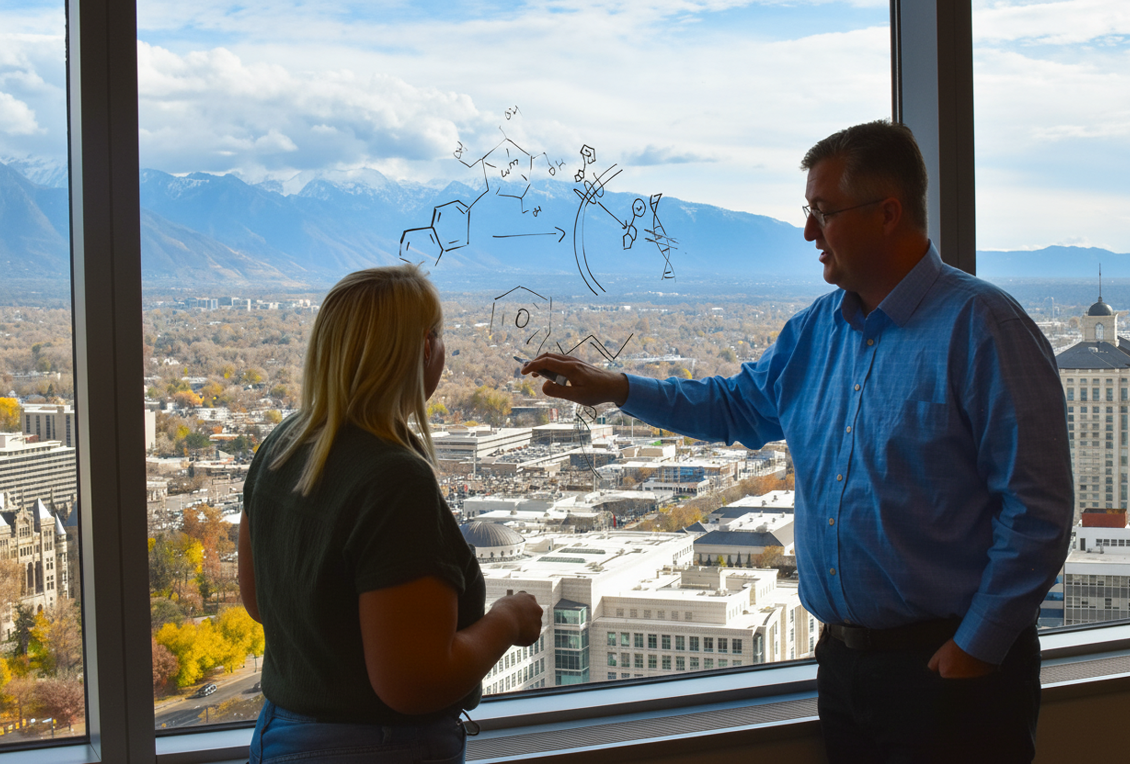
27
Our Future
Fundraising to support our vision

Slide 30
Our Future
The value of a single RLT asset starts high & rises rapidly as it progresses
(illustrative)
 | Year 1 | Year 2 | Year 3 | Year 4 | Year 5 | Year 6 | Year 7 | Year 8
Pgm 1
Preclinical
Ph 0
Ph 1 / 2
Pivotal
NDA
Mouse efficacy data
FIH Data
5 compounds
RP2D selection
Interim
Efficacy Data
1st Human
Efficacy Data
Interim data
Full data
Approval
Value inflection points
DC selected
AACR Presentation
SMMNI or EANM Presentation
ASCO Presentation
ASCO Presentation
Seed
Series A
Series B
Series C / IPO
Program Value By Stage of Development – Comparative Deals
Preclinical
Ph 0
Ph 1 / 2
Pivotal
$4B
4
6
$4.1B
BMS · RayzeBio
$3.9B
Novartis · Lutathera
Value
10
$2.4B
AZ · Fusion
2
$2.1B
Novartis · Pluvicto
3
$1.7B
Novartis · Mariana
$1.35B
BMS · Philogen
4
X
Years to acquisition
5
$1.1B
Lilly · Aktis
3
$1.1B
Lilly · Radionetics
Asset led deal
11
$0.5B
Regeneron · Telix
Platform led deal
$0
Source: Company disclosures, public filings. Deal values as of announcement date. Illustrative timeline only.

Slide 31
5x returns common in RLT; with significantly higher returns for early investors
RayzeBio
$755M Raised, >5x Return
Est. 13x for Series A investors
Acq. BMS $4.1B (Dec 2023)
Funding Our Future
Aktis
$649M Raised, 2x Return
Est. 5x for Series A investors
IPO $1.2B valuation (Jan 2026)
Point
$432M Raised, >3x Return
Est. >10x for Series A investors
Acq. Lilly $1.4B (Dec 2023)
IPO
IPO
Fusion
$364M Raised, >6x Return
Est. 11x for Series A investors
Acq. AZ $2.4B (Mar 2024)
IPO
Mariana
$250M Raised,4x Return
Acq. NVS $1.0B (May 2024)
IPO
Radionetics
$82M Raised, >10x Return
Lilly to Acq. $140M upfront
$1B upon option (Jul 2024)
Evergreen
$60M Raised, >4x Return
Acq. Lantheus >=$250M (Jan 2025)

Slide 32
Strong value trajectory towards revenue generation driven by three phases of flawless execution
Funding Our Future
+$4B
$1B
Benchmarked Valuation*
$375M
1–3 Years
3–5 Years
5+ Years
$100M
Build core business & research capabilities
Seed
Develop 5 pre-clin programs against innovative targets
Translate 2 programs to FIH imaging studies
Implement ML/AI capabilities to expedite discovery & development
Translate assets & broaden pipeline
Series A
Move 2-4 programs into Phase 1 & beyond
Replenish pre-clinical pipeline with 6+ new programs
GMP manufacturing suite expansion & operation
Revenue-generating RLT biopharma
Series B
Readouts from first pivotal studies
Commercialize first assets
Full pipeline of programs from research through to clinical development generated through flywheel
*Benchmarks based on estimated RayzeBio valuation step ups

Slide 33
Thank you
Contact
Jeevan Virk JVirk@segotx.com

Slide 34
Local investments will help Sego establish credibility & expand our footprint in China
Sego in China
Deep, growing commitment to China
Credibility within the ecosystem
Ongoing work at multiple CROs, with plans to expand as we advance discovery efforts toward the clinic.
Actively seeking JV in China to deepen our local connection
A recognized local investor signals Sego’s intentions of permanence in China and builds trust with CROs, regulators, KOLs, clinical sites and more.
Joint ventures need aligned capital
Operational leverage with local partners
Future JVs require investors who understand local deal structures, partner dynamics, and regulatory nuance. Investors can advise & guide Sego in JV discussions.
A respected local investor brings relationship social capital and accountability that a foreign entity cannot provide on its own.

